Slide 1
Insurance Project- Batch 3
Objective: Understand the Loan Status of Individuals on the basis of Income,Insurance,Credit and other parameters.

Slide 2
Data Set Details
Type: Data frame
No. of Rows: 614 ; No of Columns: 13
Data Info:
dtypes: float64(4), int64(1), object(8)
Total missing value =171. We used Python to fill out the missing values.
Data Columns | Non Null Entries | Data type | Details
ID | 614 | object | Identification No. of Customer
Gender | 601 | object | Gender of the Customer
Marrital_Status | 611 | object | Marital status of the Customer
Dependents | 599 | object | Number of Family members, customer supports financially
Education | 614 | object | Information on customers education(Graduate or Not Graduate)
Self_Employed | 582 | object | Information about customers employment (Self Employed or Not Self Employed).
ApplicantIncome | 614 | int64 | Income of the customers (INR/month).
PremiumAmount | 592 | float64 | Amount which Customers are going to pay for a policy(INR/month).
Maturity_Term | 600 | float64 | Time period of a particular policy(months).
Credit_History | 564 | float64 | Information on customers Loan payments(1= yes / 0= no).
Branch | 614 | object | Details of the branch Urban, Rural, Semiurban
Loan_Status | 614 | object | Status of customers loan (1= yes / 0= no)
Benefits | 592 | float64 | Final amount received by the customer after the maturity term ( Benefits * 100 = INR/maturity term)

Slide 3
Data Set details
Total No Of Applicants = 614
No Of Male Applicants=500; No. Of Female Applicants= 114;
No Of Married Applicants= 400; No. Of Unmarried Applicants = 214;
No Of Graduates= 480; No Of Non Graduates= 134;
Count Of Dependents: 0= 354; 1=104; 2=105 ;3+=51;
Credit History 1= 513; Credit History 0=101;
Count Of Applicant As Per Branch: Rural=179 ; Semiurban= 233 ; Urban= 202;
Loan Approved: Yes= 422; No= 192
Self Employed: Yes=86 ; No=528;

Slide 4
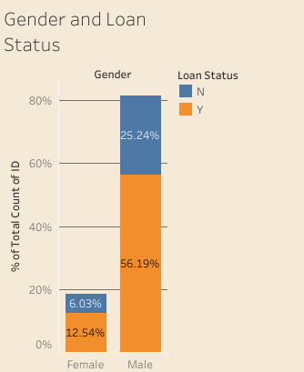
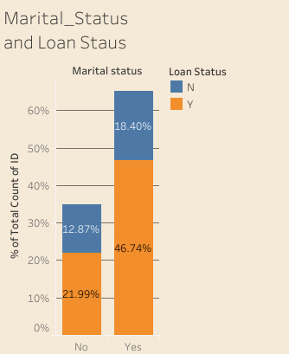
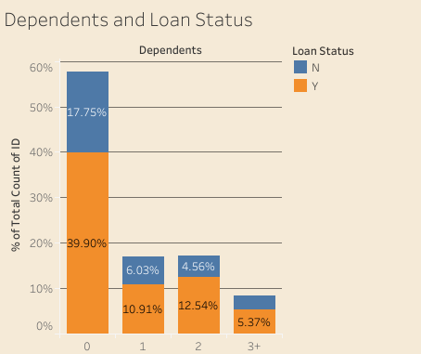
Analysis and Inferences
It can be observed that Male applicants have majority of loan approvals.
It is observed married applicants have better loan approval status.
It is observed that applicants with 0 dependents have maximum loan approval and applicants with 3+ dependents have least approvals.

Slide 5
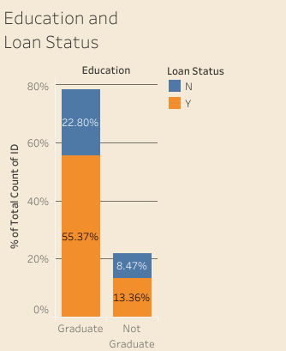
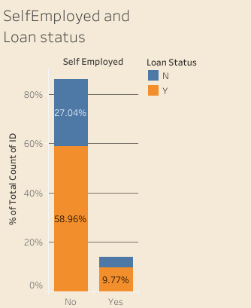
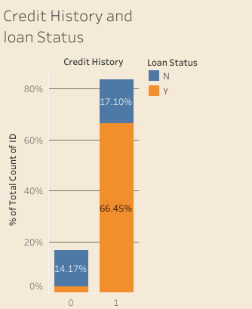
Analysis and Inferences
It is observed that Graduate applicants have maximum loan approval
Applicants who are not self employed have more no of loans approved.
Applicants with a Credit history of 1 have got maximum Loan approvals while 0 have negligible approvals.

Slide 6
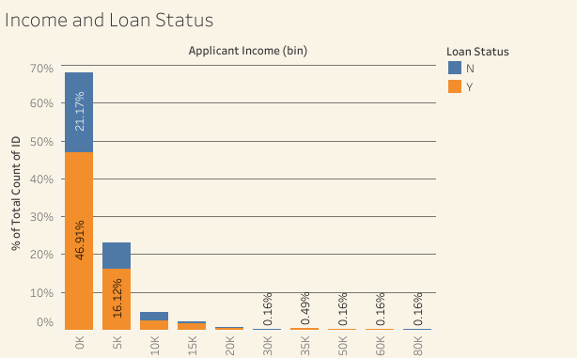
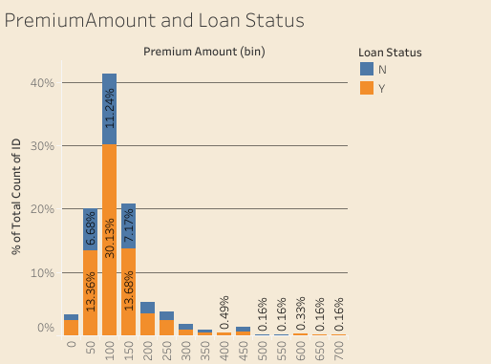
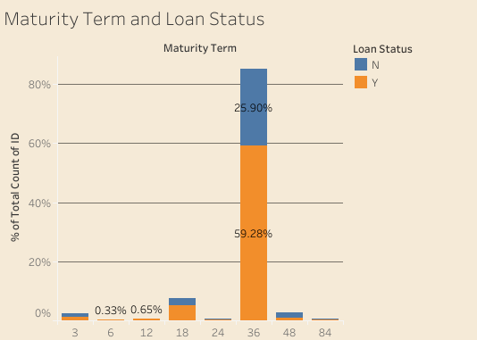
Analysis and Inferences
Applicants having income in the range of 0-5k had applied for maximum no. of loan and also have maximum approvals.
Applicants paying premium in the range of 100-150 have applied for more loans and have maximum no of approvals.
Applicants having maturity term of 36 Months have maximum no of approvals.

Slide 7
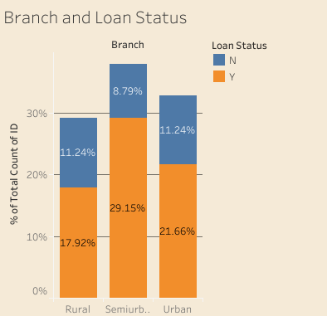
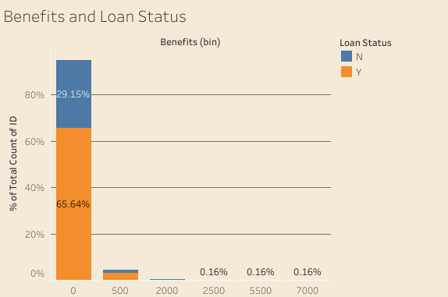
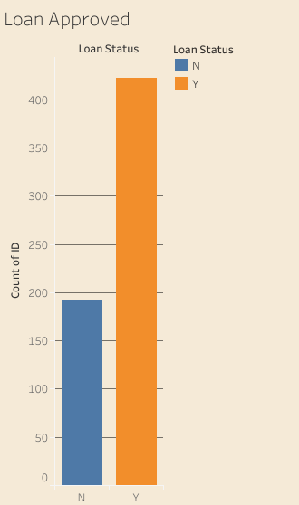
Analysis and Inferences
Individuals in Semi Urban Branch area have got more number of loans approved while approval is least in Rural area.
Individuals having benefits in range of 0-500 have applied for maximum no of loans and have maximum approvals.
Out of total 614 Applicants, 422 had got the loan approved.

Slide 8
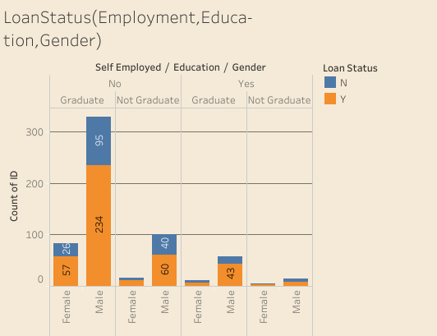
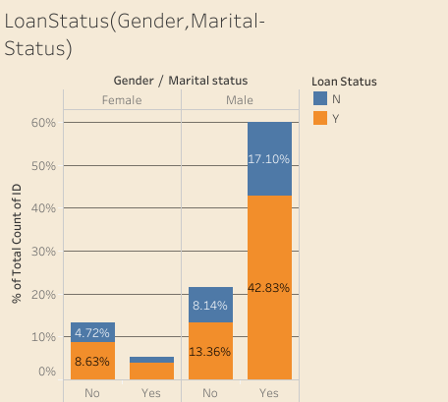
Analysis and Inferences
Graduate male who are not self employed have maximum loan approvals.
Not Graduate females who are self employed have least loan approved.
Married males applicants have got maximum no of loan approved.
Unmarried females applicants have least loan approved.

Slide 9
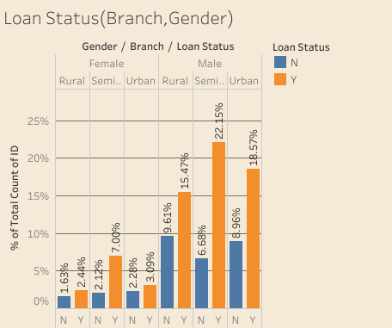
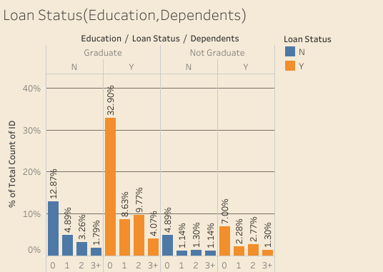
Analysis and Inferences
Male applicants in Semi urban area have majority of loan approved.
Female applicants in rural area have least loan approved.
Graduate Applicants with 0 dependents have maximum no of loans approved.
Not graduate applicants having 3+ dependents have least approvals.

Slide 10
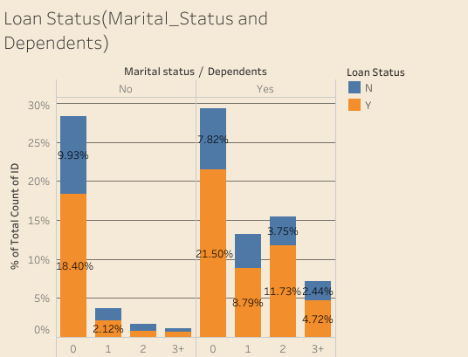
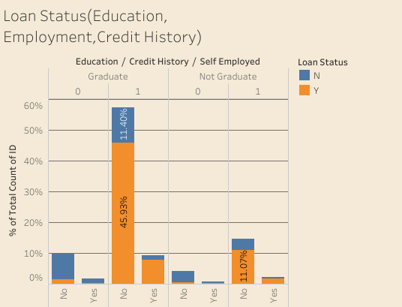
Analysis and Inferences
Married or married applicants having 0 dependents have more loans approved.
Unmarried applicants with 3+ Dependents have least loans approved.
Graduate applicants having credit history 1 and not being self employed have maximum loan approvals.
Not graduate applicants who are self employed with credit history 0 have least approvals.

Slide 11
Conclusions
Male applicants have got more loans approved.
Applicants having credit history 1 have better loan approval status.
Applicants in semi urban branch area have better loan approval status compared to urban and rural.
Applicants having 0 dependents have higher loan approvals.
Graduate applicants have maximum loans approved.
Majority of loan applicants were having benefits in range of 0-500 and they had maximum approvals.
Taking into consideration gender, education, self employed, credit history and branch, it can be observed that graduate male customers in semi urban branch area with a credit history of 1 have maximum number no loans approved.

Slide 12
 | Rural |  | Rural Total | Semiurban |  | Semiurban Total | Urban |  | Urban Total | Grand Total
Row Labels | N | Y |  | N | Y |  | N | Y
Female | 10 | 15 | 25 | 13 | 43 | 56 | 14 | 19 | 33 | 114
0 | 1 |  | 1 | 7 | 2 | 9 | 8 |  | 8 | 18
Graduate | 1 |  | 1 | 6 | 2 | 8 | 6 |  | 6 | 15
No |  |  |  | 5 | 2 | 7 | 5 |  | 5 | 12
Yes | 1 |  | 1 | 1 |  | 1 | 1 |  | 1 | 3
Not Graduate |  |  |  | 1 |  | 1 | 2 |  | 2 | 3
No |  |  |  | 1 |  | 1 | 2 |  | 2 | 3
1 | 9 | 15 | 24 | 6 | 41 | 47 | 6 | 19 | 25 | 96
Graduate | 7 | 11 | 18 | 5 | 33 | 38 | 6 | 17 | 23 | 79
No | 6 | 11 | 17 | 4 | 29 | 33 | 6 | 15 | 21 | 71
Yes | 1 |  | 1 | 1 | 4 | 5 |  | 2 | 2 | 8
Not Graduate | 2 | 4 | 6 | 1 | 8 | 9 |  | 2 | 2 | 17
No | 2 | 3 | 5 |  | 7 | 7 |  | 1 | 1 | 13
Yes |  | 1 | 1 | 1 | 1 | 2 |  | 1 | 1 | 4
Male | 59 | 95 | 154 | 41 | 136 | 177 | 55 | 114 | 169 | 500
0 | 27 | 5 | 32 | 22 | 4 | 26 | 22 | 3 | 25 | 83
Graduate | 19 | 4 | 23 | 17 | 2 | 19 | 12 | 2 | 14 | 56
No | 16 | 4 | 20 | 16 | 2 | 18 | 9 | 1 | 10 | 48
Yes | 3 |  | 3 | 1 |  | 1 | 3 | 1 | 4 | 8
Not Graduate | 8 | 1 | 9 | 5 | 2 | 7 | 10 | 1 | 11 | 27
No | 7 | 1 | 8 | 4 | 1 | 5 | 9 | 1 | 10 | 23
Yes | 1 |  | 1 | 1 | 1 | 2 | 1 |  | 1 | 4
1 | 32 | 90 | 122 | 19 | 132 | 151 | 33 | 111 | 144 | 417
Graduate | 20 | 69 | 89 | 15 | 107 | 122 | 26 | 93 | 119 | 330
No | 18 | 54 | 72 | 14 | 89 | 103 | 22 | 84 | 106 | 281
Yes | 2 | 15 | 17 | 1 | 18 | 19 | 4 | 9 | 13 | 49
Not Graduate | 12 | 21 | 33 | 4 | 25 | 29 | 7 | 18 | 25 | 87
No | 11 | 18 | 29 | 3 | 23 | 26 | 6 | 16 | 22 | 77
Yes | 1 | 3 | 4 | 1 | 2 | 3 | 1 | 2 | 3 | 10
Grand Total | 69 | 110 | 179 | 54 | 179 | 233 | 69 | 133 | 202 | 614
Above Analysis takes into consideration Gender, Education, Self Employed, credit History and Branch into consideration. It can be observed that Graduate Male Customers in Semi urban branch area with a credit history of 1 have maximum number no loans approved.

Slide 13
Thank you

